Slide 1

BANK LOAN CASE STUDY
PROJECT 6
NAME – Shalini Pathak
TRAINITY – Data Analytics Course

Slide 2
ABOUT PROJECT
We are going to analyze Bank loans system in this project , The dataset we will be working with contains information about loan applications. It includes Customers with payment difficulties and cases where the payment was made on time.
In this project we need to use EDA (Exploratory Data Analysis) to understand how customer attributes and loan attributes influence the likelihood of default.
When a customer applies for a loan, there are four possible outcomes:
Approved: The company has approved the loan application.
Cancelled: The customer cancelled the application during the approval process.
Refused: The company rejected the loan.
Unused Offer: The loan was approved but the customer did not use it.
The main aim of this project is to identify patterns that indicate if a customer will have difficulty paying their installments. This information can be used to make decisions such as denying the loan, reducing the amount of loan, or lending at a higher interest rate to risky applicants.

Slide 3
TASK GIVEN
Identify Missing Data and Deal with it Appropriately
Identify Outliers in the Dataset
Analyze Data Imbalance
Perform Univariate, Segmented Univariate, and Bivariate Analysis
Identify Top Correlations for Different Scenarios

Slide 4
GIVEN
We are provided with two dataset which contains huge number of data :-
Application_data
Prevoius_application
After Data Cleaning
ROWS
50003
COLUMN
122
ROWS
50003
COLUMN
31
https://docs.google.com/spreadsheets/d/1SAdeeRhKH8N4g5pvI_03Rwcmpuh3P9mG/edit?usp=sharing&ouid=116064238907054497678&rtpof=true&sd=true
ROWS
50000
COLUMN
37
ROWS
50003
COLUMN
33
https://docs.google.com/spreadsheets/d/1DKVzjWWHhMD_A0E3U-TJ5ypomVo8Vufg/edit?usp=sharing&ouid=116064238907054497678&rtpof=true&sd=true

Slide 5
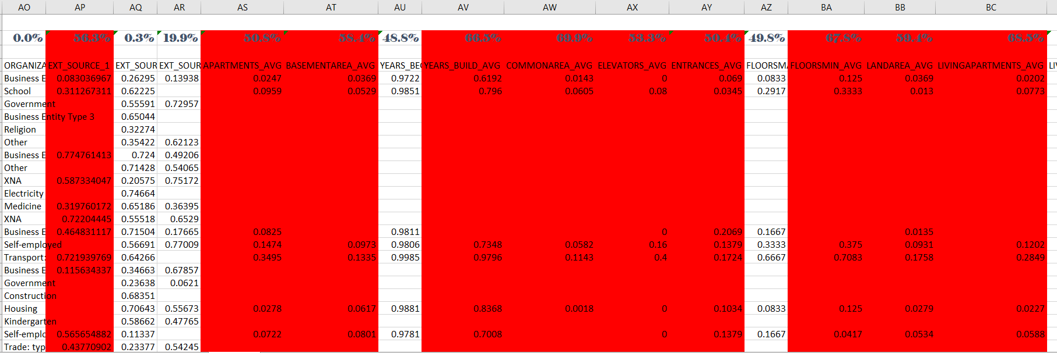
APPLICATION DATA
There are huge number of columns containing null values > 50% so we will drop these columns

Slide 6
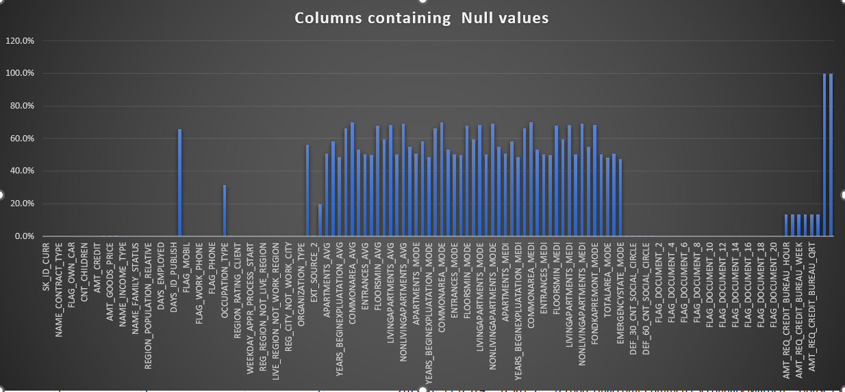

Slide 7
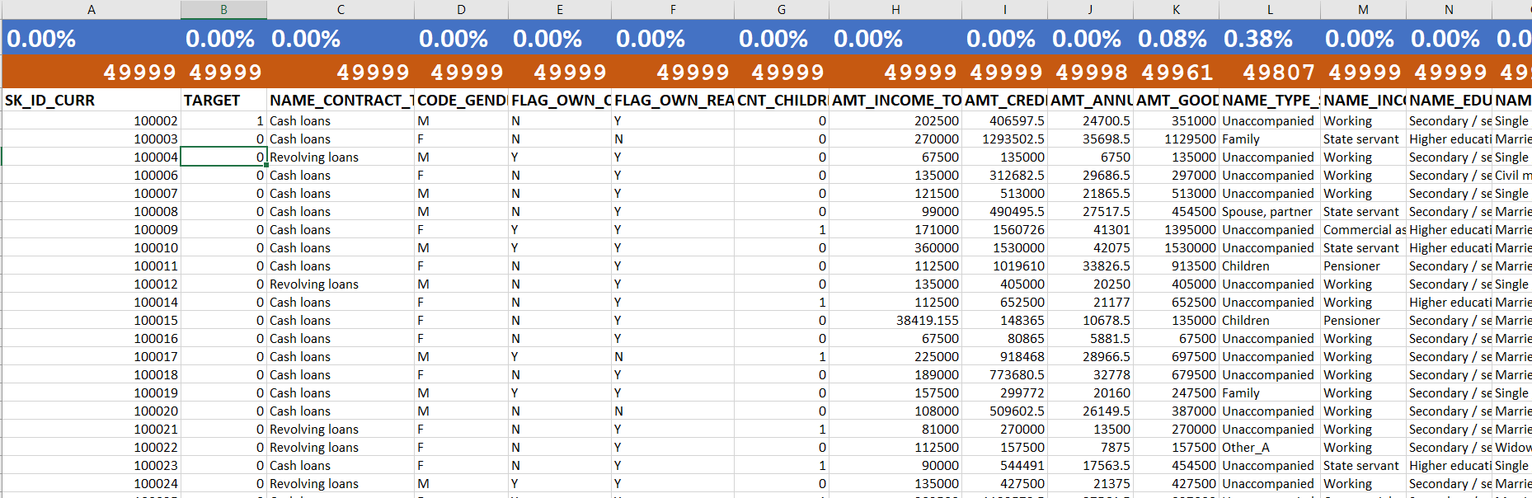
This is cleaned data where I have calculated count of values in each column and null values < 50%
All the null values are replaced with “NA” to get the error free and cleaned data.

Slide 8
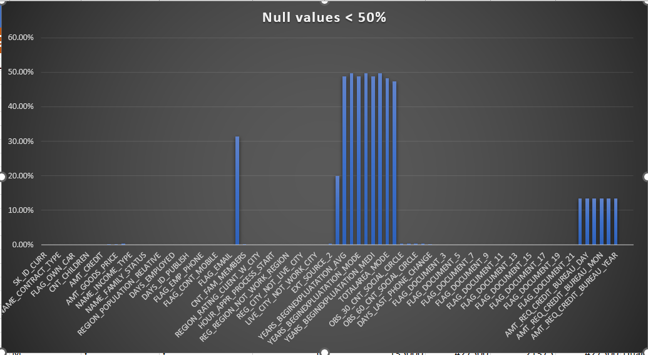

Slide 9
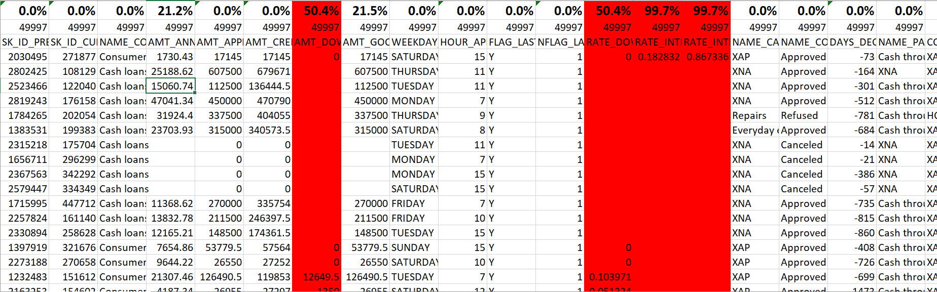
PREVIOUS APPLICATION DATA
The given dataset contains 4 to 5 columns with huge number of null values so we will select and drop these columns.

Slide 10
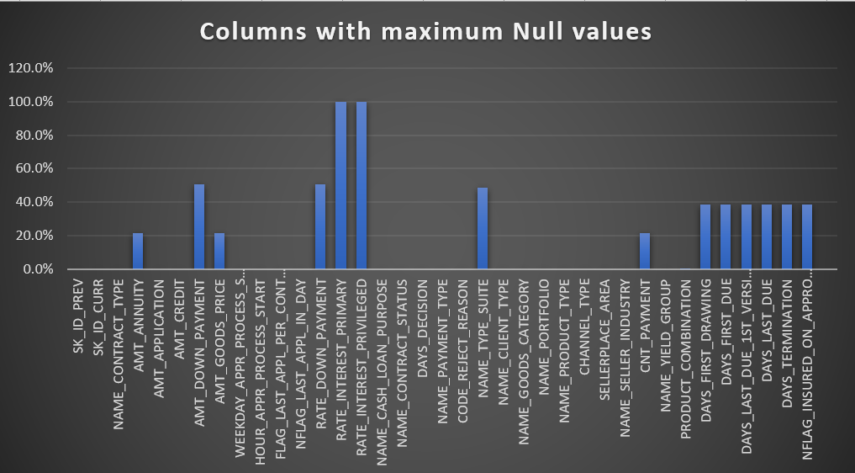

Slide 11
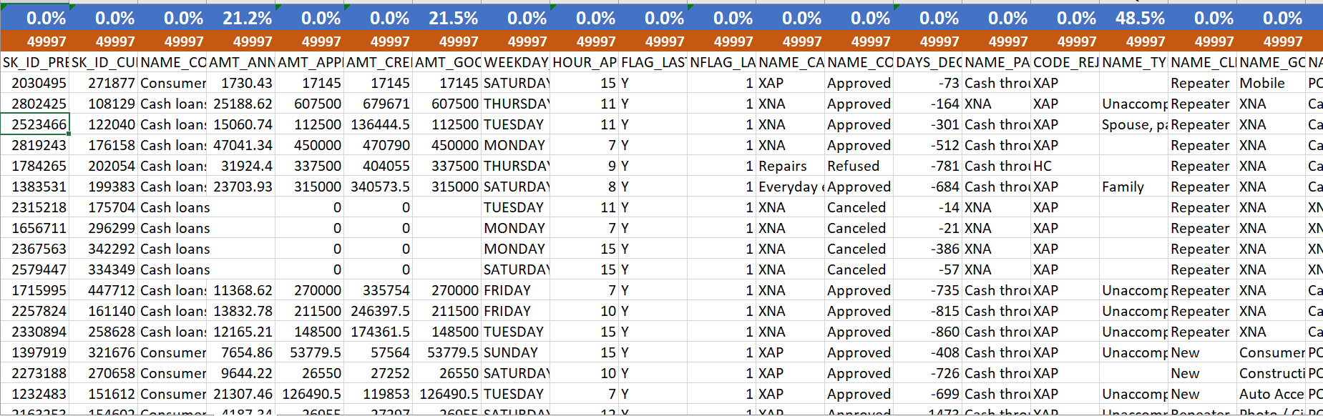
This is a cleaned data which contains null value < 50% and I have also included the count of each column

Slide 12
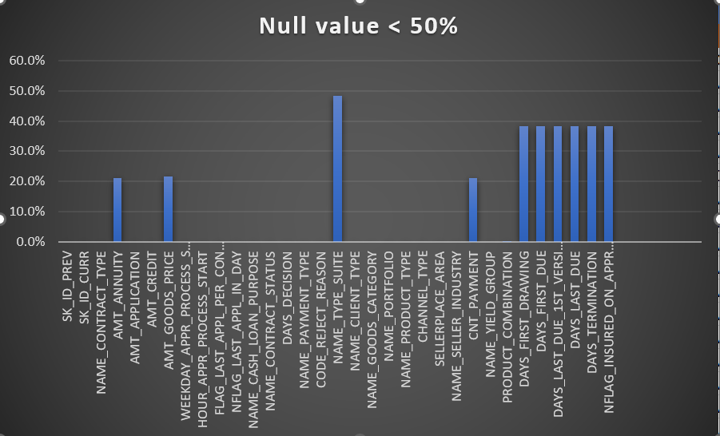

Slide 13
2 . IDENTIFY OUTLIERS IN DATASET
Outliers are data points or observations that are significantly different from the majority of the data in a dataset.
They can be unusually high or low values and can distort statistical analyses and data visualizations if not properly identified and managed.
Outliers can occur for various reasons, including data entry errors, measurement errors, natural variation, or genuinely exceptional events or conditions.
We will first identify the numerical columns present in the data set.
We will calculate the quartile and interquartile range using formulas and we will also calculate thresholds to determine if the outliers are valid data points or require further investigation.
FORMULAS : -
Q1 = (= QUARTILE 1 (Range , 1))
Q3 = ( =QUARTILE 3(Range , 3))
For Interquartile range use
IQR = (=Q3-Q1)
Lower Thresholds
=Q1-1.5*IQR
Higher Thresholds
=Q3-1.5*IQR
Now we will insert a scatter plot or box plot for each numerical column.
The calculation is done for both application_data and previous_applicationdata dataset.

Slide 14
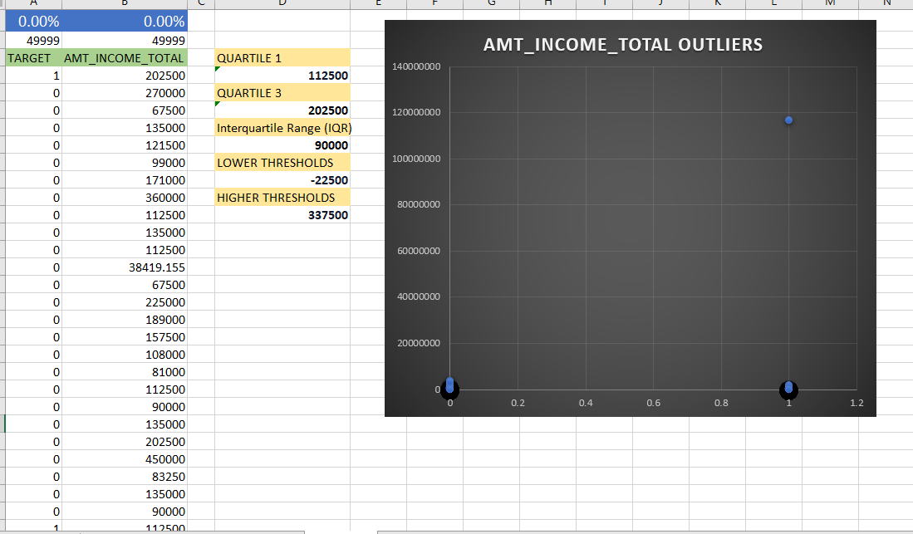
APPLICATION_DATA

Slide 15
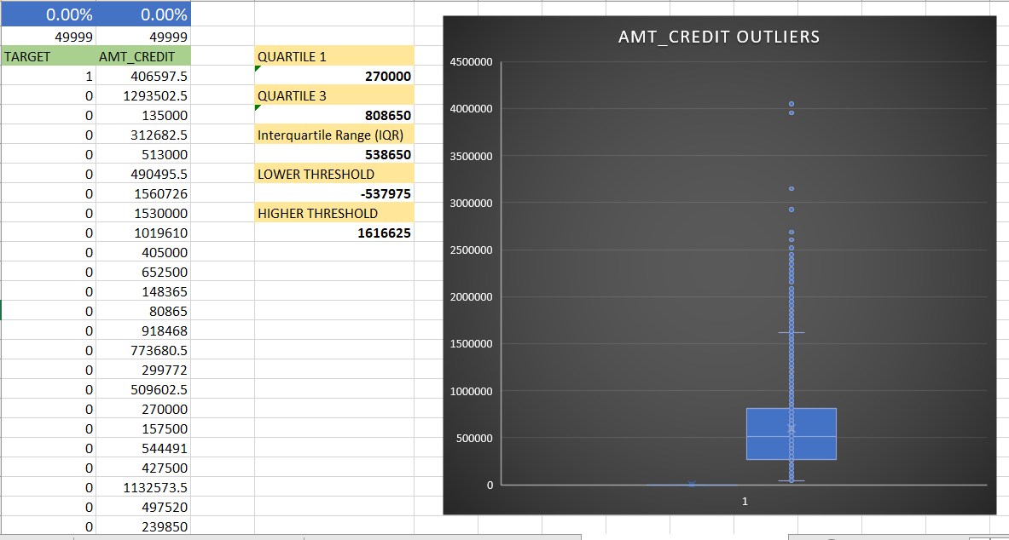

Slide 16
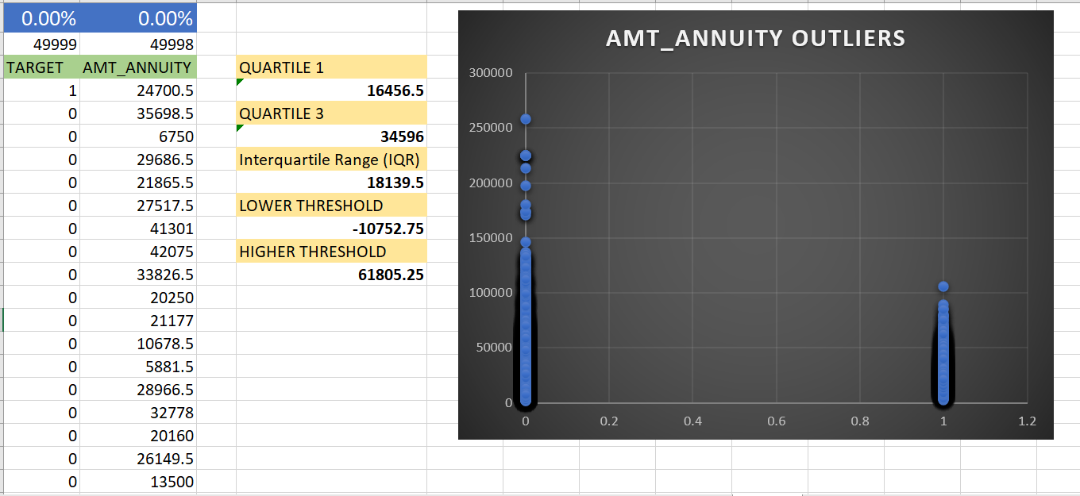
ABOUT PROJECT

Slide 17
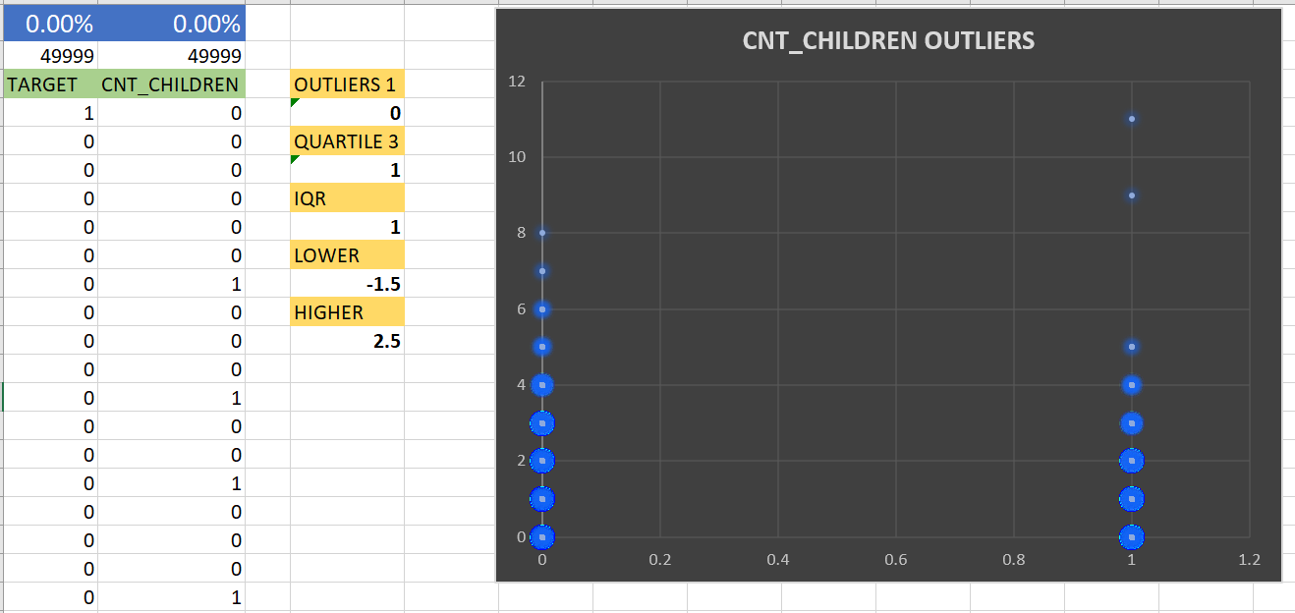
ABOUT PROJECT

Slide 18
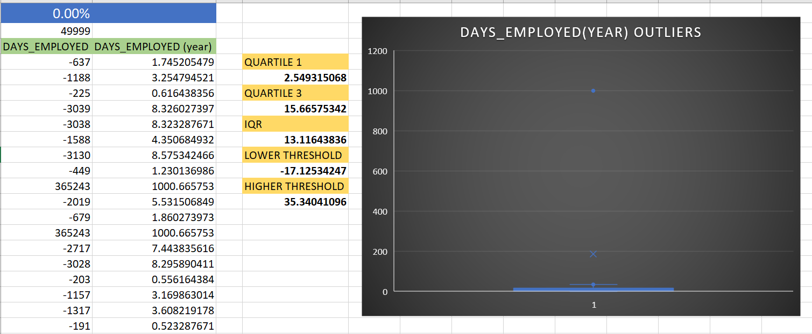
ABOUT PROJECT
EXCEL LINK
https://docs.google.com/spreadsheets/d/1tI6Q8CHrLSkNJygG9VKHQSTyqqjDd0xX/edit?usp=sharing&ouid=116064238907054497678&rtpof=true&sd=true

Slide 19
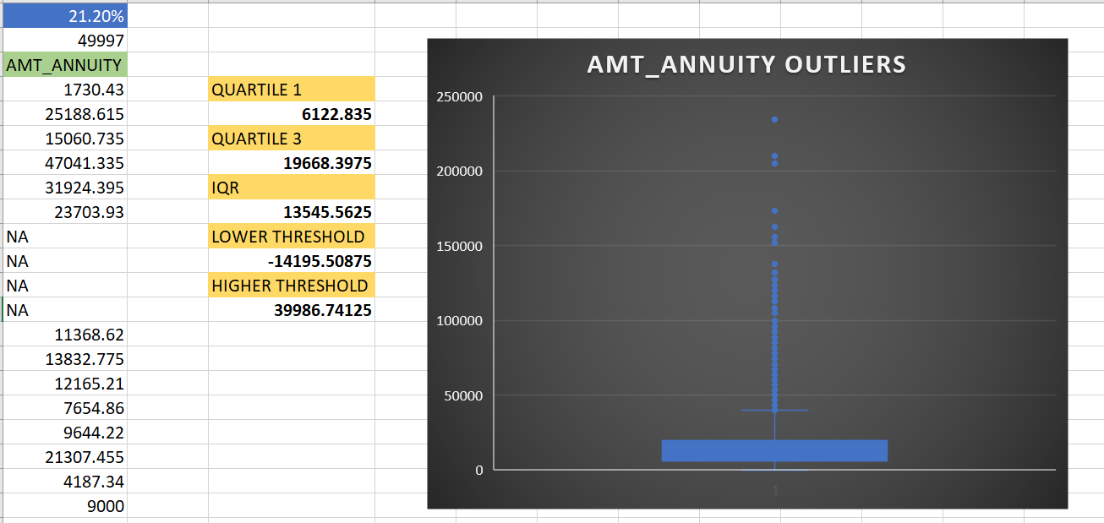
Previous_application_data

Slide 20
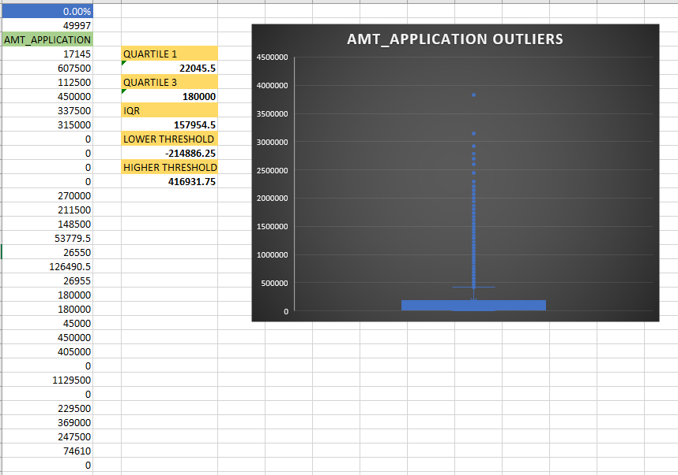
ABOUT PROJECT

Slide 21
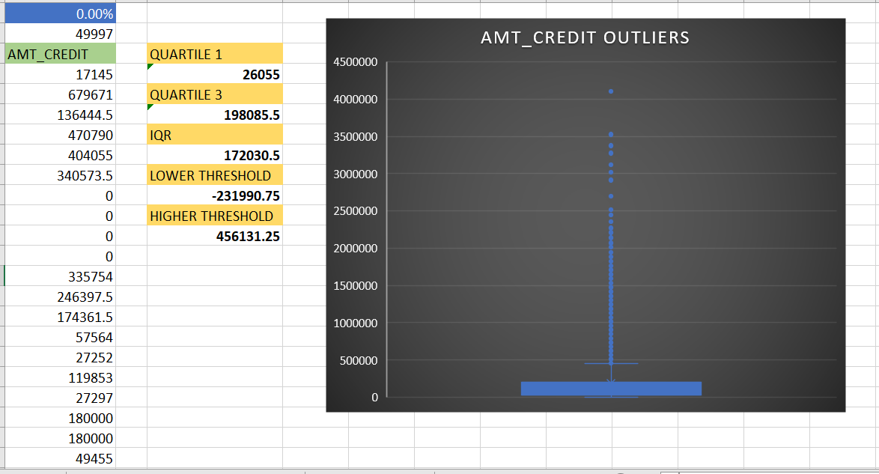
ABOUT PROJECT

Slide 22
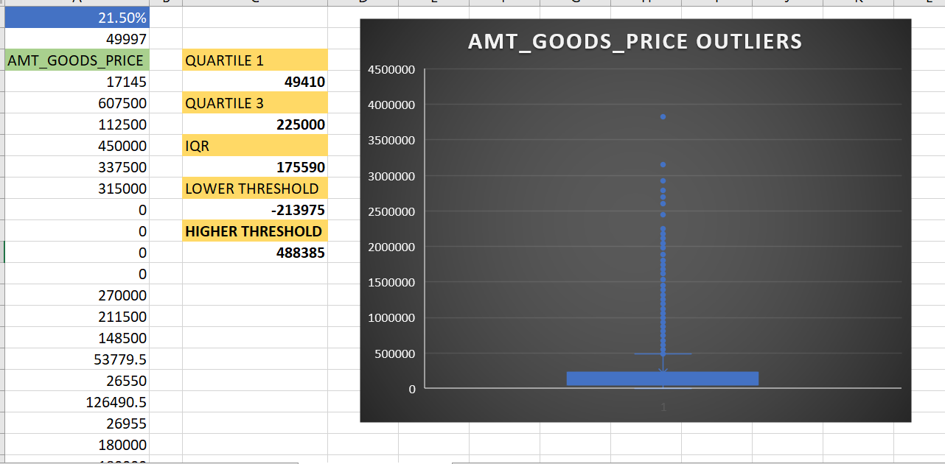
ABOUT PROJECT
EXCEL LINK :-
https://docs.google.com/spreadsheets/d/1DKVzjWWHhMD_A0E3U-TJ5ypomVo8Vufg/edit?usp=sharing&ouid=116064238907054497678&rtpof=true&sd=true

Slide 23
ABOUT PROJECT
3. ANALYZE DATA IMBALANCE
Detecting data imbalance is essential in many machine learning and data analysis tasks, as it can affect the performance and reliability of models.
To determine if there is data imbalance in the loan application dataset and calculate the ratio of data imbalance using Excel functions, follow these steps:
STEPS :-
We will solve this problem using pivot table.
Select the entire data present in a sheet.
Now go to insert tab and insert pivot table, you will be redirected towards new sheet know on the left side of screen you can see all the columns of your data.
Drag the “Target” column towards rows this will give you all the unique values present in target column.
Now again select target column and drag it towards value this will give you the count of each variables present.
Now calculate the ration of all the values present.
We see that we have :
▪ 91% as loan re-payers
▪ 9% as Defaulters
Which gives us a clear indication
that the data is highly imbalance.
EXCEL LINK
https://docs.google.com/spreadsheets/d/1a4zDIIaJXAElnq6O6HySPxxLS2ozJE6M/edit?usp=sharing&ouid=116064238907054497678&rtpof=true&sd=true

Slide 24
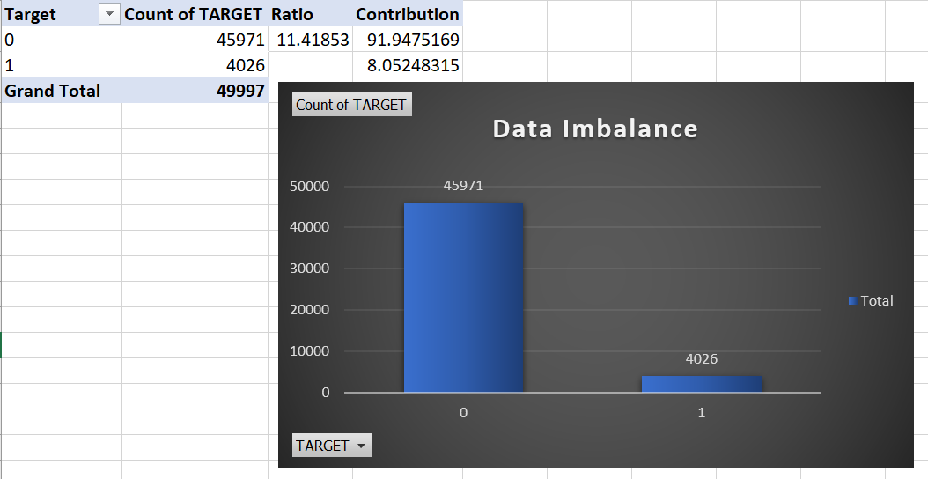
ABOUT PROJECT

Slide 25
4. Perform Univariate, Segmented Univariate, and Bivariate Analysis
Univariate analysis looks at a single variable in isolation, segmented univariate analysis examines a single variable across different subgroups, and bivariate analysis studies the relationship between two variables.
The choice of analysis technique depends on the research questions and objectives, as well as the nature of the data being analyzed.
To gain insights into the driving factors of loan default, it is important to conduct various analyses on consumer and loan attributes.
In the given dataset there are various columns where we can use these analysis and create different charts explaining everything in details.
Create stacked bar charts or grouped bar charts to compare variable distributions across different scenarios.
Excel Link :-
https://docs.google.com/spreadsheets/d/1TgviN0h2LhKeghjo34bpYaFe0vxNFmCv/edit?usp=sharing&ouid=116064238907054497678&rtpof=true&sd=true

Slide 26
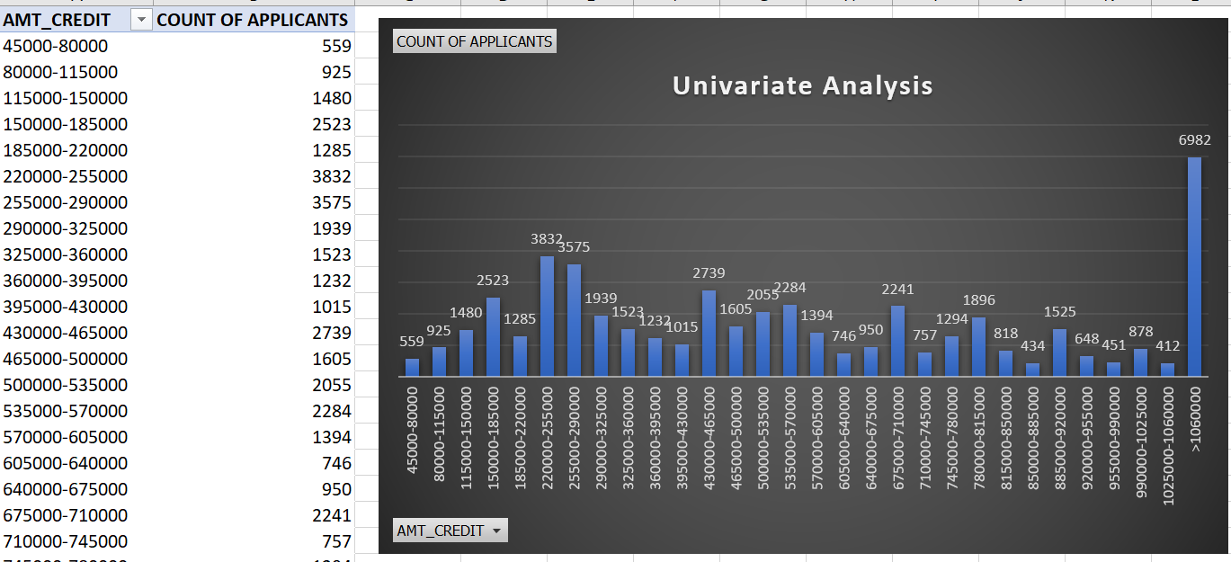

Slide 27
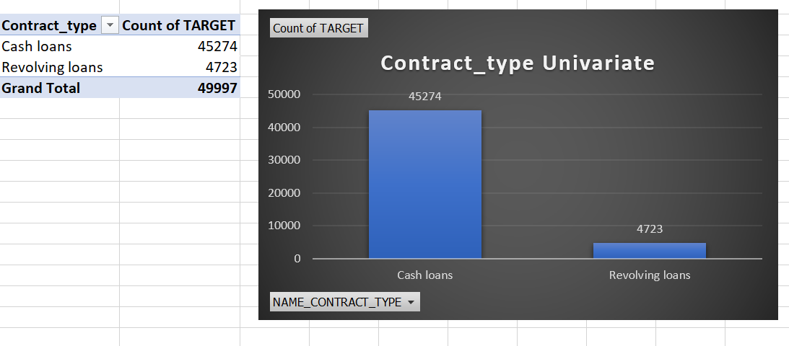

Slide 28
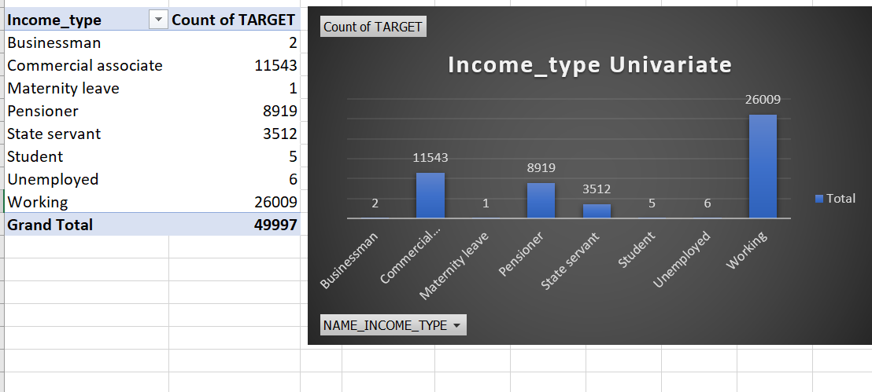

Slide 29
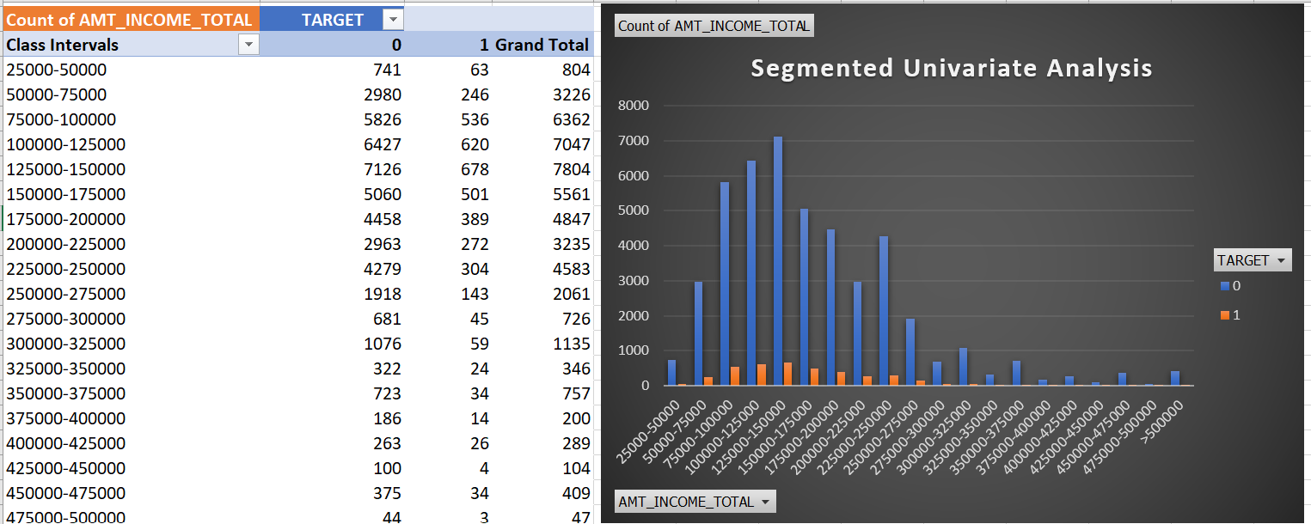

Slide 30
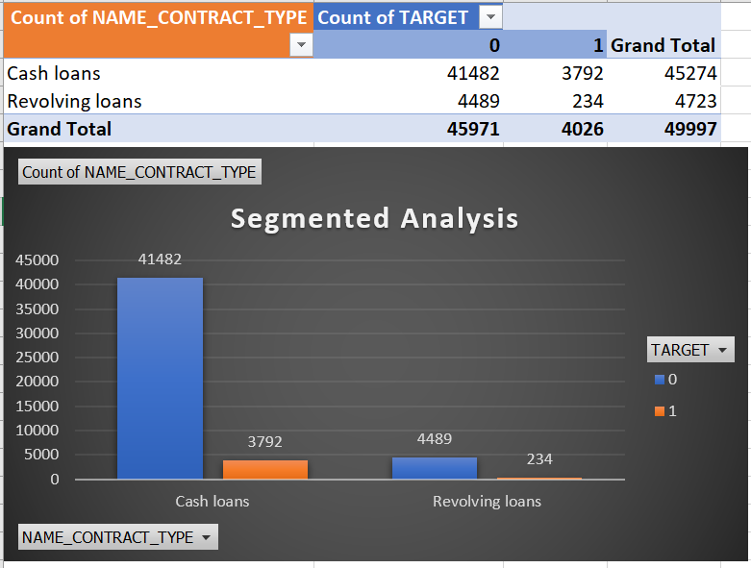

Slide 31
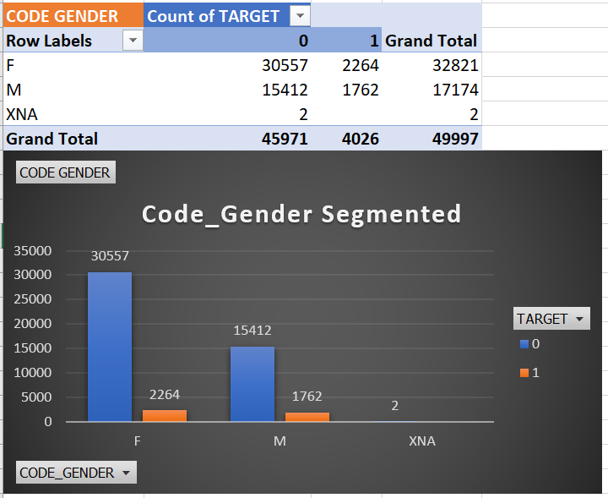

Slide 32
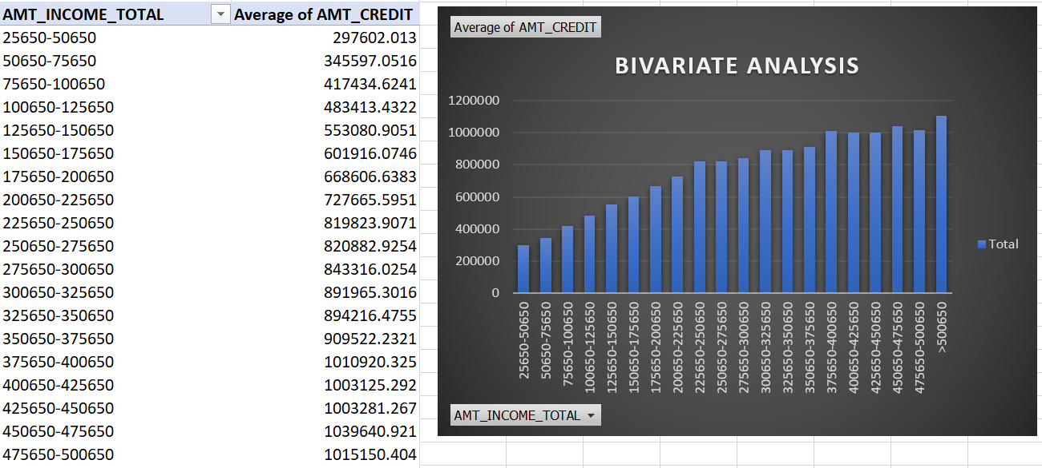

Slide 33
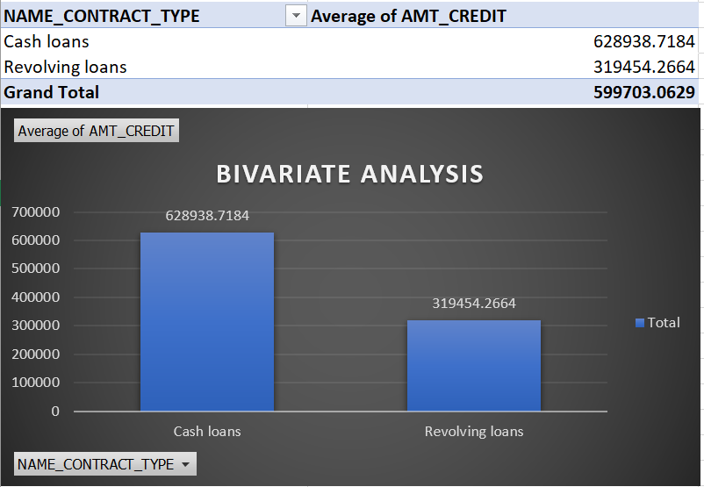

Slide 34
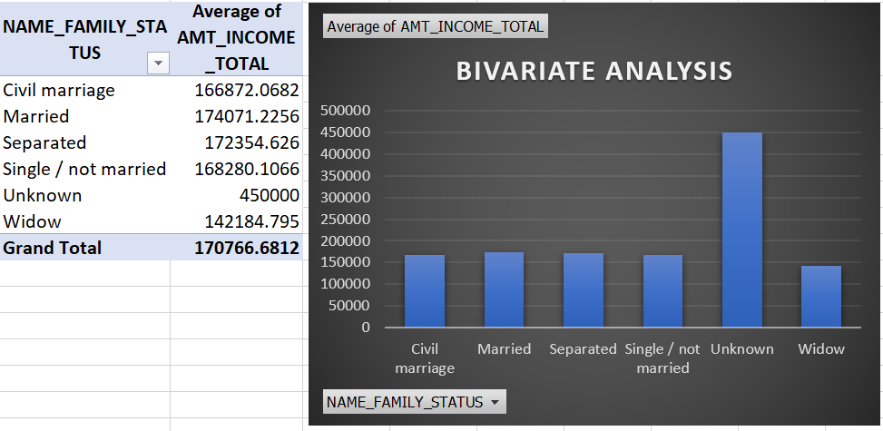

Slide 35
5. Identify Top Correlations for Different Scenarios
A correlation matrix, in statistical analysis, is a table or matrix that displays the pairwise correlation coefficients between multiple variables.
Each cell in the matrix represents the correlation between two variables, indicating the strength and direction of their relationship. It is a valuable tool for understanding how variables are related to each other in a dataset.
The correlation coefficient quantifies the degree and direction of a linear relationship between two variables. It can range from -1 to 1, with -1 indicating a perfect negative correlation, 1 indicating a perfect positive correlation, and 0 indicating no correlation.
FORMULA USED:-
=CORREL('TARGET 1'!$B:$B,'TARGET 1'!B:B)
Excel Link :-
https://docs.google.com/spreadsheets/d/1dJmPhD4LZpCcrxC8FEz7byn5B7aezgyO/edit?usp=sharing&ouid=116064238907054497678&rtpof=true&sd=true

Slide 36
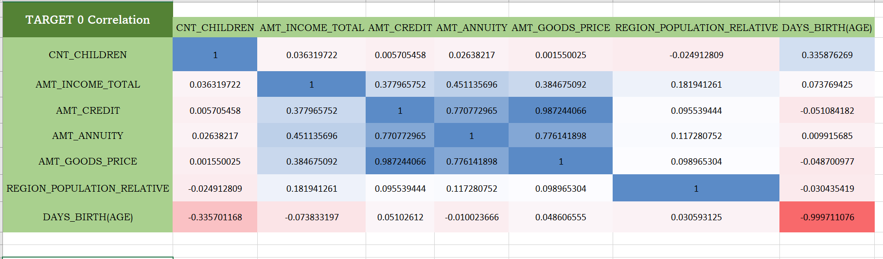

Slide 37
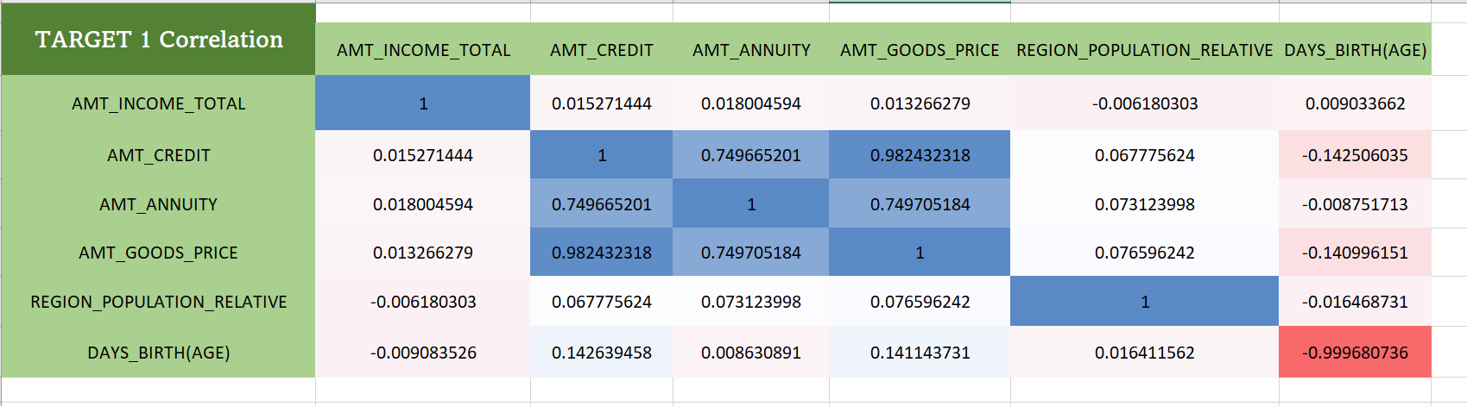

Slide 38
THANK YOU!

